Slide 1

Introductory Statistics
Introductory Statistics

Slide 2
Inference for One Proportion
Confidence Intervals
Hypothesis Testing

Slide 3
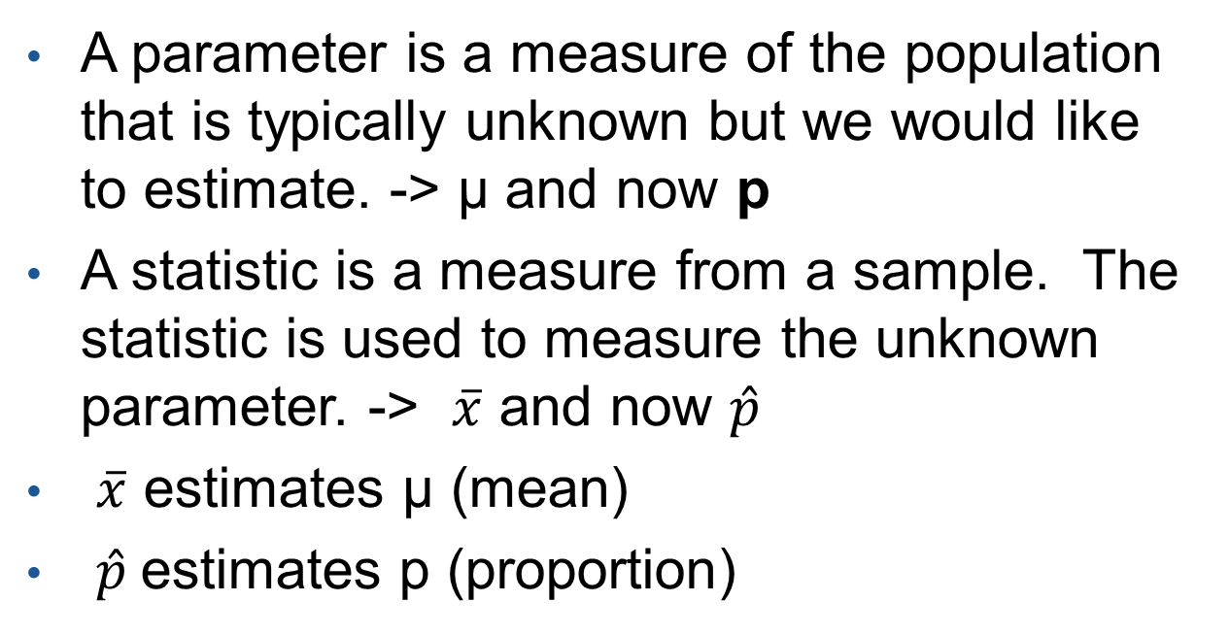
Parameter and Statistic
A parameter is a measure of the population that is typically unknown but we would like to estimate. -> µ and now p
A statistic is a measure from a sample. The statistic is used to measure the unknown parameter. -> $\overline{x}$ and now $\hat{p}$
$\overline{x}$ estimates µ (mean)
$\hat{p}$estimates p (proportion)

Slide 4
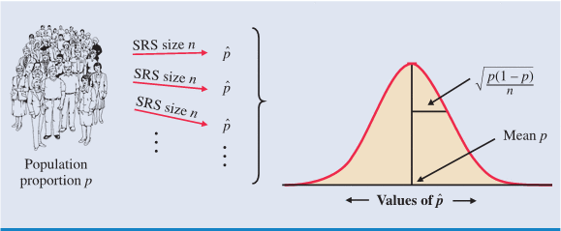
Distribution of a Sample Proportion
Sampling Distributions has many sample proportions from many samples
Due to time and money, one cannot take multiple samples or sample the whole population. So, we infer based on one sample.
The statistic from the sample can be anywhere in the sampling distribution.

Slide 5
Confidence Interval
A confidence interval for an unknown parameter consists of an interval of numbers.
Point Estimate ±Margin of Error (Sampling Error)
Example: People voting for Barack Obama (Pre-election polling)

Slide 6
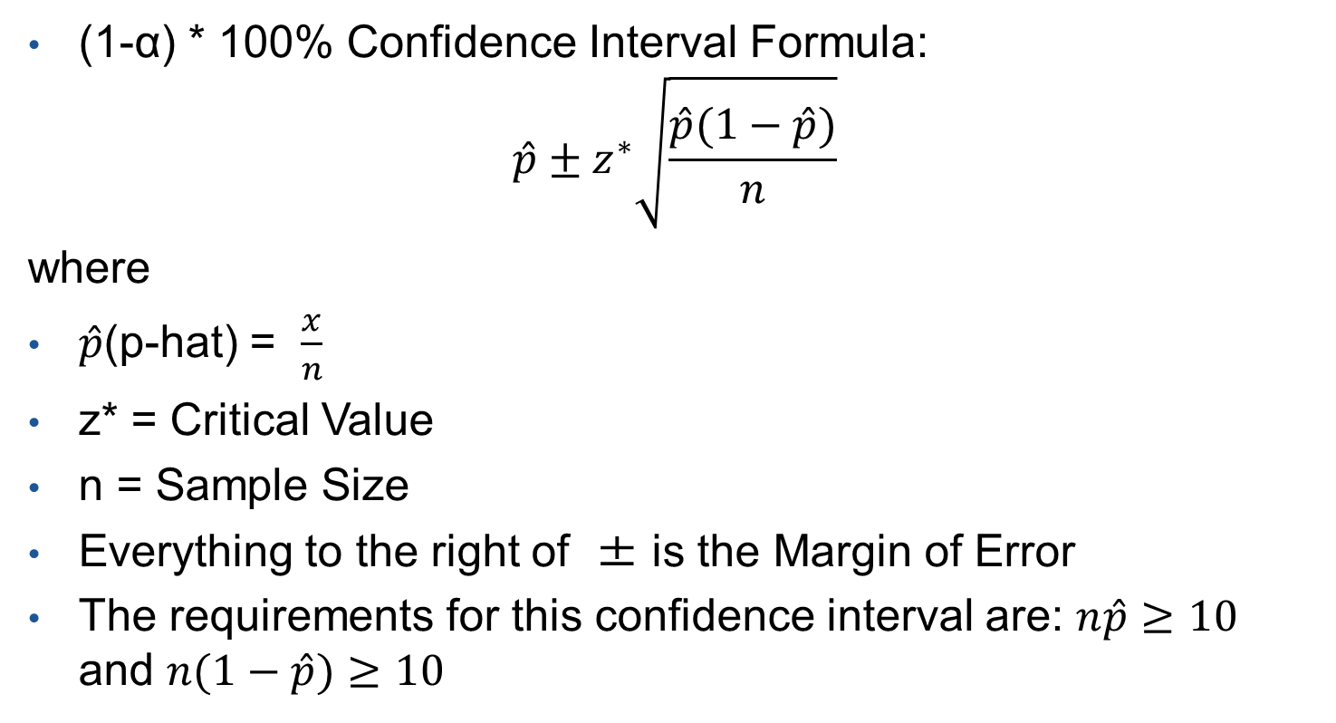
Confidence Interval (Con’t)
(1-α) * 100% Confidence Interval Formula:
$$\hat{p}±z^{∗}\sqrt{\frac{\hat{p}(1−\hat{p})}{n}}$$
where
$\hat{p}$(p-hat) = $\frac{x}{n}$
z* = Critical Value
n = Sample Size
Everything to the right of ± is the Margin of Error
The requirements for this confidence interval are: $n\hat{p}≥10$ and $n(1−\hat{p})≥10$

Slide 7
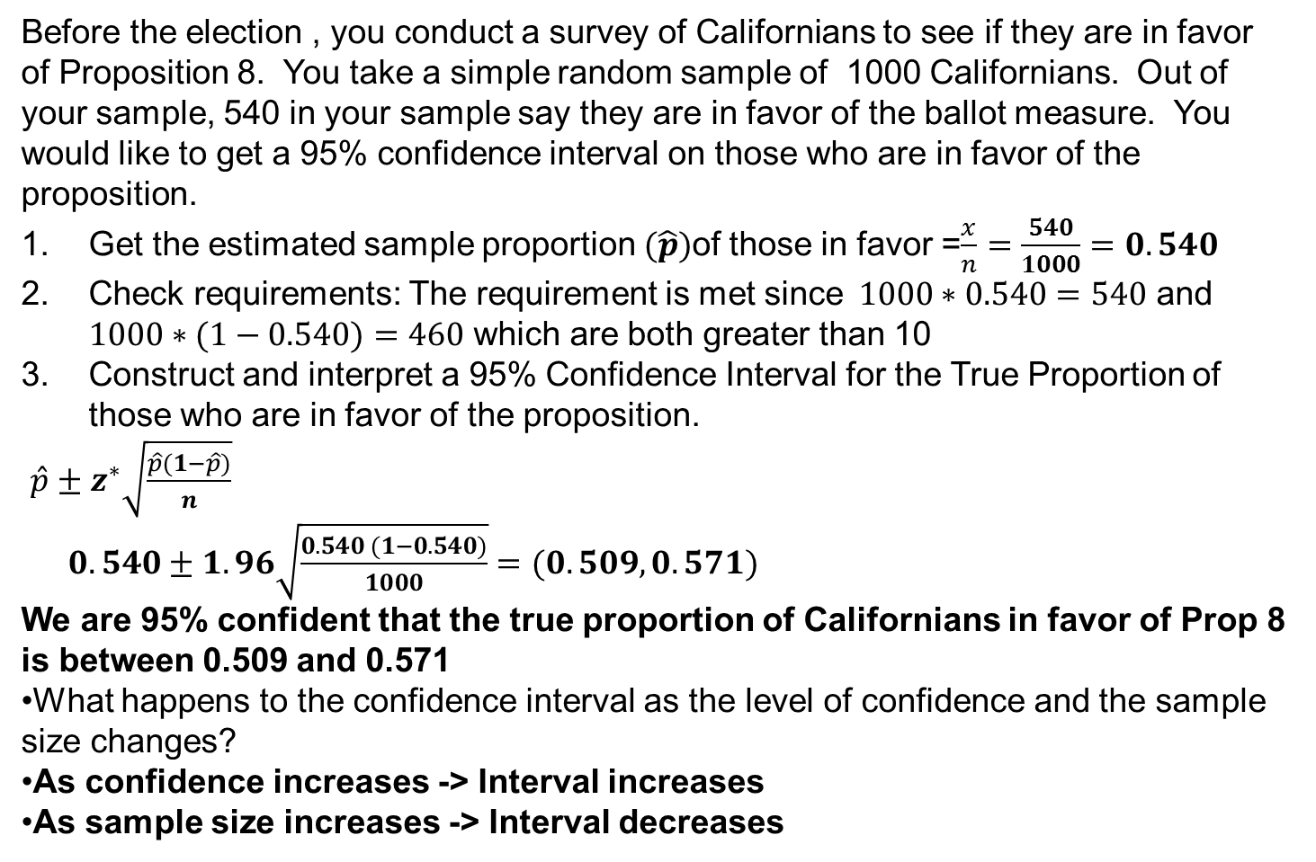
Confidence Interval (Example)
Before the election , you conduct a survey of Californians to see if they are in favor of Proposition 8. You take a simple random sample of 1000 Californians. Out of your sample, 540 in your sample say they are in favor of the ballot measure. You would like to get a 95% confidence interval on those who are in favor of the proposition.
Get the estimated sample proportion $(\hat{p})$of those in favor =$\frac{x}{n}=\frac{540}{1000}=0.540$
Check requirements: The requirement is met since$1000∗0.540=540$ and $1000∗(1−0.540)=460$ which are both greater than 10
Construct and interpret a 95% Confidence Interval for the True Proportion of those who are in favor of the proposition.
$\hat{p}±z^{∗}\sqrt{\frac{\hat{p}(1−\hat{p})}{n}}$
$0.540±1.96\sqrt{\frac{0.540 (1−0.540)}{1000}}=(0.509,0.571)$
We are 95% confident that the true proportion of Californians in favor of Prop 8 is between 0.509 and 0.571
What happens to the confidence interval as the level of confidence and the sample size changes?
As confidence increases -> Interval increases
As sample size increases -> Interval decreases

Slide 8
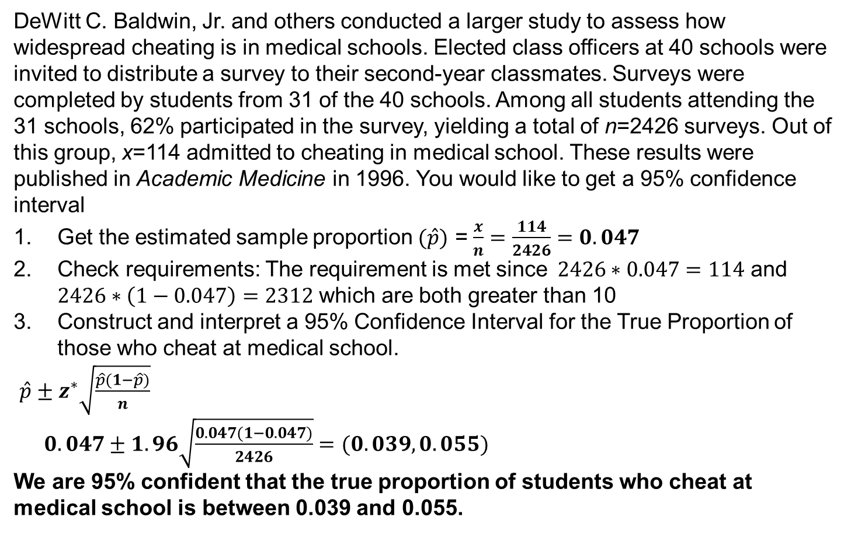
Confidence Interval (Example)
DeWitt C. Baldwin, Jr. and others conducted a larger study to assess how widespread cheating is in medical schools. Elected class officers at 40 schools were invited to distribute a survey to their second-year classmates. Surveys were completed by students from 31 of the 40 schools. Among all students attending the 31 schools, 62% participated in the survey, yielding a total of n=2426 surveys. Out of this group, x=114 admitted to cheating in medical school. These results were published in Academic Medicine in 1996. You would like to get a 95% confidence interval
Get the estimated sample proportion $(\hat{p})$ = $\frac{x}{n}=\frac{114}{2426}=0.047$
Check requirements: The requirement is met since$2426∗0.047=114$ and $2426∗\left(1−0.047\right)=2312$ which are both greater than 10
Construct and interpret a 95% Confidence Interval for the True Proportion of those who cheat at medical school.
$\hat{p}±z^{∗}\sqrt{\frac{\hat{p}(1−\hat{p})}{n}}$
$0.047±1.96\sqrt{\frac{0.047(1−0.047)}{2426}}=(0.039,0.055)$
We are 95% confident that the true proportion of students who cheat at medical school is between 0.039 and 0.055.

Slide 9
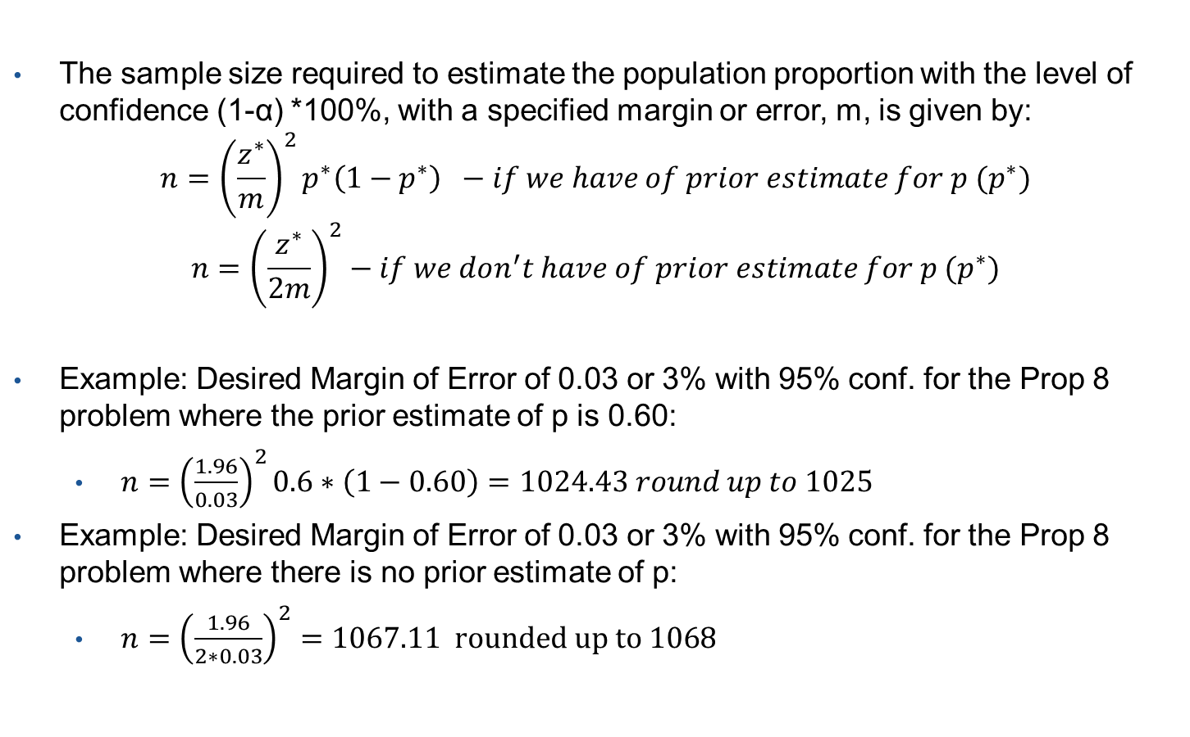
Sample Size Calculations
The sample size required to estimate the population proportion with the level of confidence (1-α) *100%, with a specified margin or error, m, is given by:
$$n={\left(\frac{z^{∗}}{m}\right)}^{2}p^{∗}\left(1−p^{∗}\right) −if we have of prior estimate for p (p^{∗})$$
$$n={\left(\frac{z^{∗}}{2m}\right)}^{2}−if we don^{′}t have of prior estimate for p (p^{∗})$$
Example: Desired Margin of Error of 0.03 or 3% with 95% conf. for the Prop 8 problem where the prior estimate of p is 0.60:
$n={\left(\frac{1.96}{0.03}\right)}^{2}0.6∗\left(1−0.60\right)=1024.43 round up to 1025$
Example: Desired Margin of Error of 0.03 or 3% with 95% conf. for the Prop 8 problem where there is no prior estimate of p:
$n={\left(\frac{1.96}{2∗0.03}\right)}^{2}=1067.11 rounded up to 1068$

Slide 10

Sample Size Calculations
Example: Desired Margin of Error of 0.03 or 3% with 95% conf. for the sample of cases from the Superior Courts in Massachusetts where the prior estimate of p is 0.82:
$n={\left(\frac{1.96}{0.03}\right)}^{2}0.82∗\left(1−0.82\right)=630.02 round up to 631$

Slide 11
More Thoughts on Confidence Intervals
A level of confidence describes the process of creating an interval that predicts the proportion, p, which is unknown. Approx. (1-α) *100% of all possible confidence intervals will contain p.
This does not mean the probability of containing p. The interval captured it or it did not. (Prob. = 0 or 1).

Slide 12
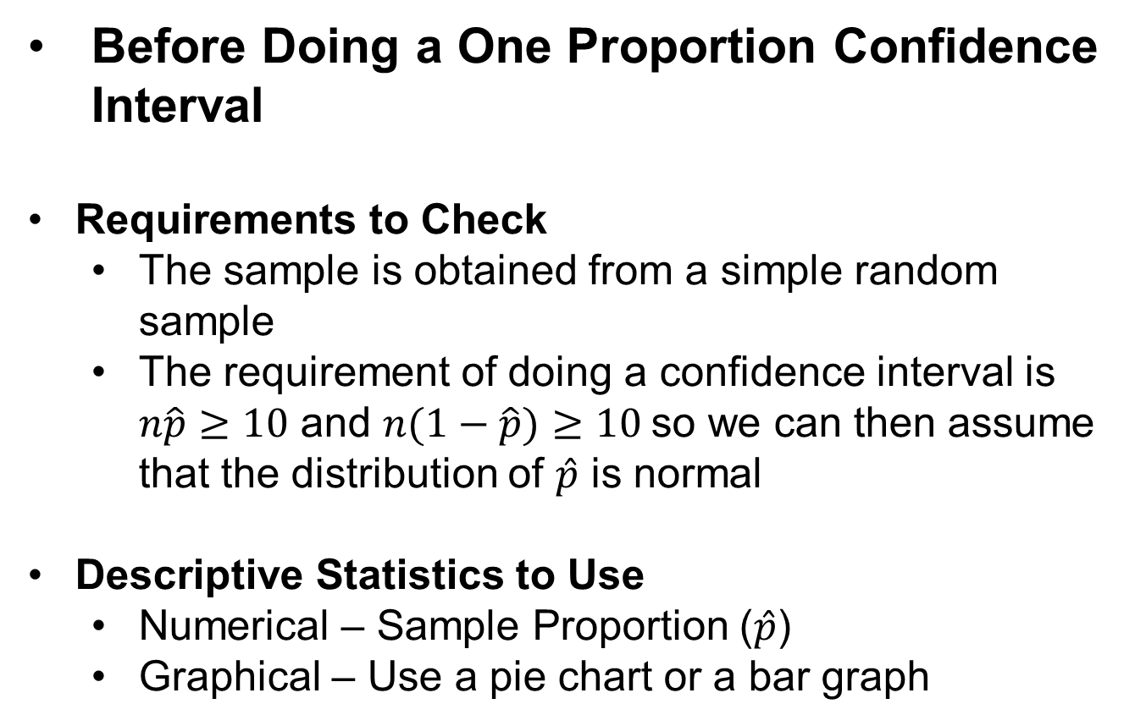
Requirements to Check and Descriptive Statistics
Before Doing a One Proportion Confidence Interval
Requirements to Check
The sample is obtained from a simple random sample
The requirement of doing a confidence interval is $n\hat{p}≥10$ and $n(1−\hat{p})≥10$so we can then assume that the distribution of $\hat{p}$ is normal
Descriptive Statistics to Use
Numerical – Sample Proportion ($\hat{p}$)
Graphical – Use a pie chart or a bar graph

Slide 13
Inference for One Proportion
Confidence Intervals
Hypothesis Testing

Slide 14

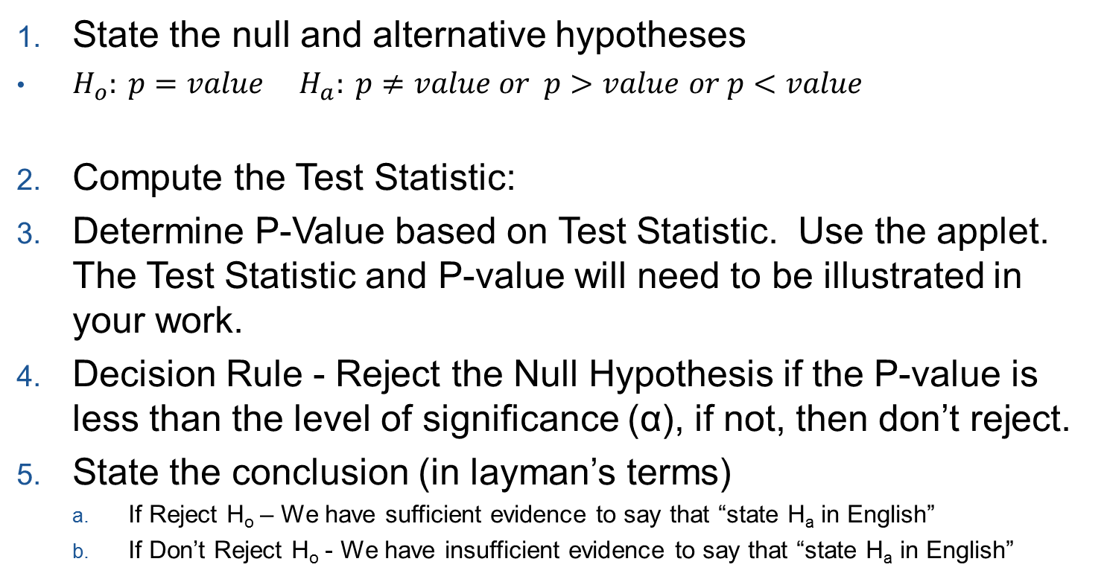
Steps to Hypothesis Testing
State the null and alternative hypotheses
$H_{o}: p=value$ $H_{a}: p≠value or p>value$ $or p<value$
Compute the Test Statistic:
Determine P-Value based on Test Statistic. Use the applet. The Test Statistic and P-value will need to be illustrated in your work.
Decision Rule - Reject the Null Hypothesis if the P-value is less than the level of significance (α), if not, then don’t reject.
State the conclusion (in layman’s terms)
If Reject H_{o} – We have sufficient evidence to say that “state H_{a} in English”
If Don’t Reject H_{o} - We have insufficient evidence to say that “state H_{a} in English”

Slide 15
One Proportion

Slide 16
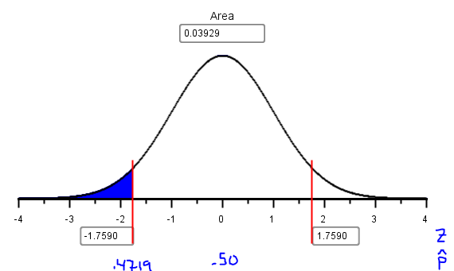
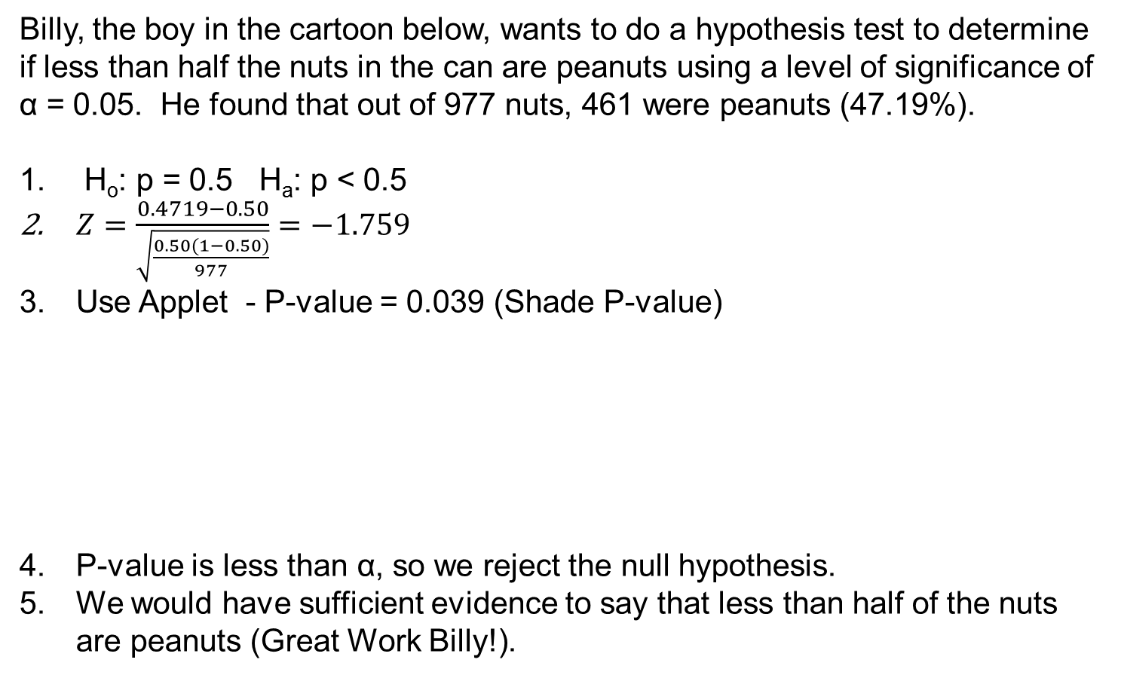
Test of Hypothesis (Example)
Billy, the boy in the cartoon below, wants to do a hypothesis test to determine if less than half the nuts in the can are peanuts using a level of significance of α = 0.05. He found that out of 977 nuts, 461 were peanuts (47.19%).
H_{o}: p = 0.5 H_{a}: p < 0.5
$Z=\frac{0.4719−0.50}{\sqrt{\frac{0.50(1−0.50)}{977}}}=−1.759$
Use Applet - P-value = 0.039 (Shade P-value)
P-value is less than α, so we reject the null hypothesis.
We would have sufficient evidence to say that less than half of the nuts are peanuts (Great Work Billy!).

Slide 17
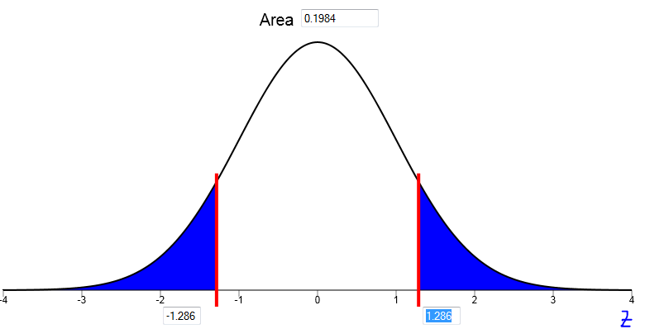
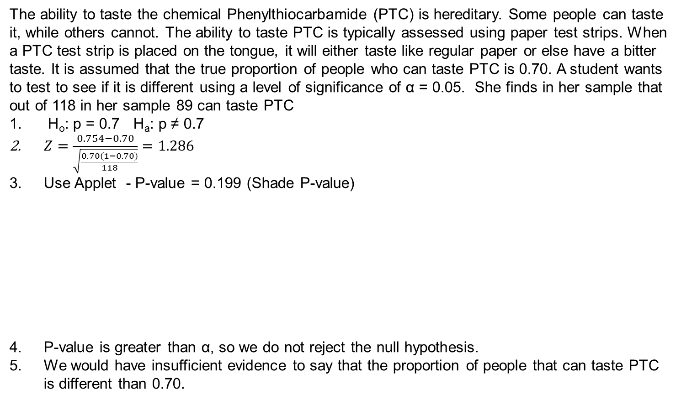
Test of Hypothesis (Example)
The ability to taste the chemical Phenylthiocarbamide (PTC) is hereditary. Some people can taste it, while others cannot. The ability to taste PTC is typically assessed using paper test strips. When a PTC test strip is placed on the tongue, it will either taste like regular paper or else have a bitter taste. It is assumed that the true proportion of people who can taste PTC is 0.70. A student wants to test to see if it is different using a level of significance of α = 0.05. She finds in her sample that out of 118 in her sample 89 can taste PTC
H_{o}: p = 0.7 H_{a}: p ≠ 0.7
$Z=\frac{0.754−0.70}{\sqrt{\frac{0.70(1−0.70)}{118}}}=1.286$
Use Applet - P-value = 0.199 (Shade P-value)
P-value is greater than α, so we do not reject the null hypothesis.
We would have insufficient evidence to say that the proportion of people that can taste PTC is different than 0.70.

Slide 18
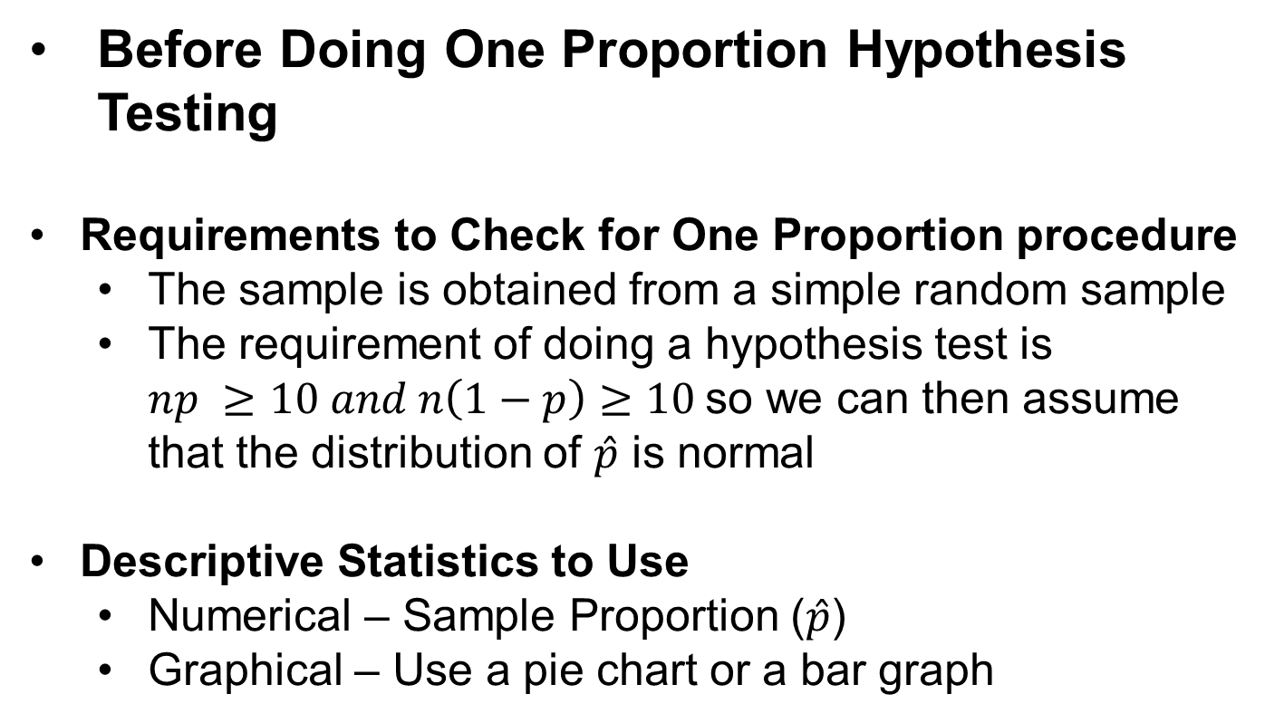
Requirements to Check and Descriptive Statistics
Before Doing One Proportion Hypothesis Testing
Requirements to Check for One Proportion procedure
The sample is obtained from a simple random sample
The requirement of doing a hypothesis test is $np ≥10 and n\left(1−p\right)≥10$so we can then assume that the distribution of $\hat{p}$ is normal
Descriptive Statistics to Use
Numerical – Sample Proportion ($\hat{p}$)
Graphical – Use a pie chart or a bar graph

